Slide 1
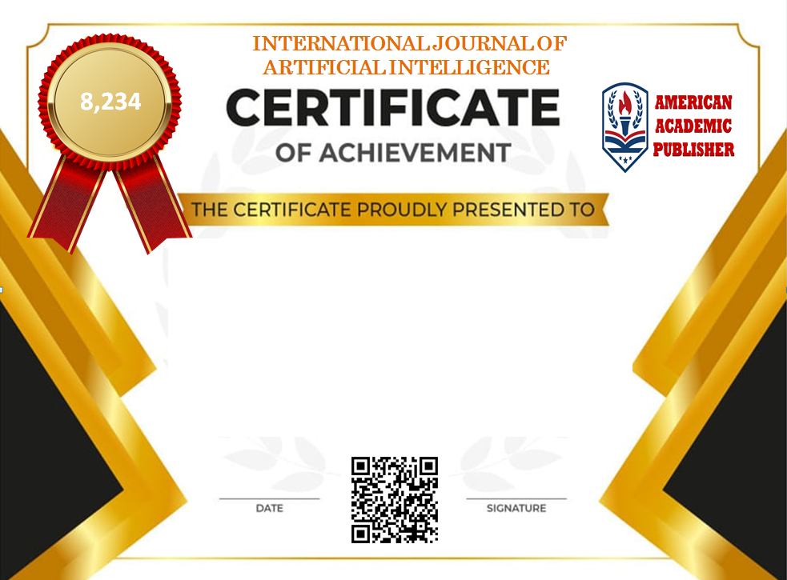


Karimova Nozima Nurmukhamadovna
PEDAGOGICAL PARADIGMS OF DEVELOPMENT OF PROFESSIONAL COMPETENCE IN TEACHERS OF PROFESSIONAL EDUCATION
17.11.2024

